Slide 1
Classifying Fabric Patterns Using Deep Learning Project
SlideMake.com

Slide 2

Introduction to Fabric Pattern Classification
Fabric pattern classification is essential for textile quality control and inventory management.
Deep learning techniques have significantly improved the accuracy and efficiency of pattern recognition tasks.
This project aims to develop a model that accurately classifies various fabric patterns using convolutional neural networks (CNNs).
Notes:
Image source: https://cdn.educba.com

Slide 3

Importance of Fabric Pattern Recognition
Automated pattern classification reduces the need for manual inspection, saving time and labor costs.
Accurate classification enhances product categorization and customization in the fashion industry.
Reliable pattern recognition can assist in detecting fabric defects and inconsistencies during manufacturing.
Notes:
Image source: https://www.slidemake.com

Slide 4
Dataset Collection and Preparation
We collected a diverse dataset of fabric images representing various patterns such as floral, striped, and plaid.
Data augmentation techniques like rotation, scaling, and flipping were applied to increase dataset size and variability.
The dataset was split into training, validation, and testing sets to evaluate model performance effectively.
Notes:
Image source: https://source.roboflow.com

Slide 5

Data Preprocessing Techniques
Images were resized to a uniform dimension suitable for CNN input, typically 128x128 or 224x224 pixels.
Normalization was performed to scale pixel values between 0 and 1, aiding model convergence.
Data augmentation was utilized to improve model robustness against overfitting and enhance generalization.
Notes:
Image source: https://www.xenonstack.com

Slide 6
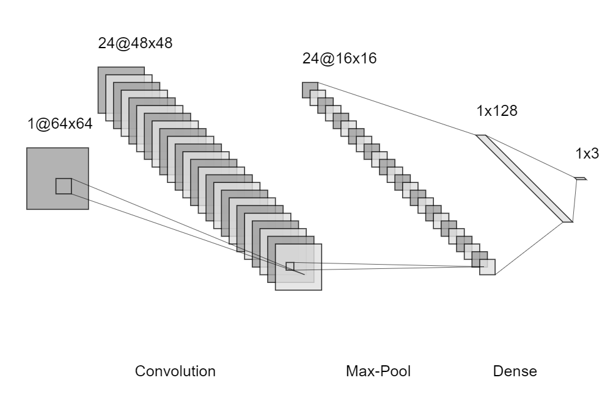
Model Selection and Architecture
A convolutional neural network (CNN) architecture was chosen due to its effectiveness in image classification tasks.
Pre-trained models like VGG16 or ResNet50 were considered for transfer learning to leverage existing learned features.
The final model architecture was fine-tuned for fabric pattern classification with additional dense layers.
Notes:
Image source: https://machinelearningtheory.org

Slide 7
Training Process and Hyperparameters
The model was trained using a categorical cross-entropy loss function with an Adam optimizer.
Key hyperparameters included learning rate, batch size, and number of epochs, optimized through experimentation.
Early stopping and learning rate scheduling were employed to prevent overfitting and improve accuracy.
Notes:
Image source: https://www.researchgate.net

Slide 8
Model Evaluation and Results
The model achieved an accuracy of over 90% on the test set, indicating strong pattern recognition capabilities.
Confusion matrices revealed the model's effectiveness in distinguishing similar fabric patterns.
Precision, recall, and F1-score metrics were calculated to assess the model's overall performance comprehensively.
Notes:
Image source: https://www.slidemake.com

Slide 9
Applications and Use Cases
The classification system can be integrated into textile manufacturing for real-time quality assessment.
Fashion retailers can use this technology to automate inventory sorting and categorization.
The model can assist designers in fabric pattern selection by quickly identifying fabric types from images.
Notes:
Image source: https://www.slidemake.com

Slide 10
Challenges and Future Directions
Variability in fabric texture, lighting conditions, and image quality pose challenges to accurate classification.
Future work may include expanding the dataset with more pattern types and real-world images.
Incorporating advanced deep learning techniques like attention mechanisms can further improve model performance.
Notes:
Image source: https://www.slidemake.com

Slide 11

Conclusion and Summary
Deep learning provides a powerful approach for fabric pattern classification with high accuracy and efficiency.
The developed model demonstrates potential for practical applications in textile and fashion industries.
Ongoing improvements and dataset expansion will enhance the robustness and applicability of this fabric classification system.
Notes:
Image source: https://i.pinimg.com

